Slide 1






PFM as an enabler for improved performance and better accountability Session 7 Global Flagship Course on Health Systems Strengthening: The Challenge of Universal Health Coverage Srinivas Gurazada, Sr Financial Management Specialist, Adanna Deborah Ugochi Chukwuma, Health Specialist & TTL Saro Tsaturyan, PFM in Health consultant Makich Khcheyan, PFM in Health consultant

Slide 2

Session outline
Country PFM systems: The foundations
PEFA approach to PFM in Armenia
Rationale for focus on PFM in Health
FinHealth: Framework Assessing PFM in Health for service delivery
Global experiences
Deep dive into Armenia PFM in Health
Discussion

Slide 3
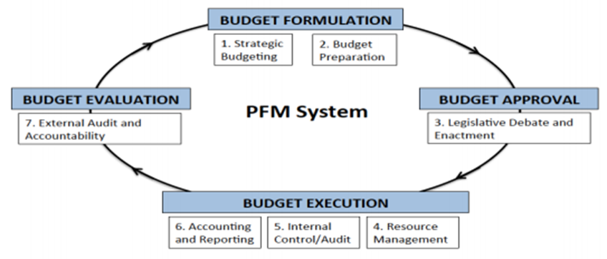
What is Public Financial Management (PFM) ?
Source: Andrew et al: This is PFM (2014)

Slide 4
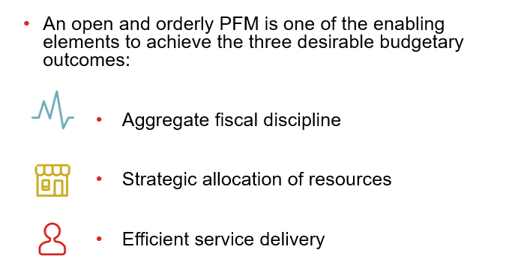
Why is Public Financial Management (PFM) key for performance and accountability?

Slide 5







PEFA approach: Pillars of PFM performance
Pillar One
Budget reliability
Pillar Two
Transparency of public finances
Pillar Three
Management of assets and liabilities
Pillar Four
Policy-based fiscal
strategy and budgeting
Pillar Five
Predictability and control in budget execution
Pillar Six
Accounting and reporting
Pillar Seven
External scrutiny and audit

Slide 6
Armenia PEFA 2014: Strong national PFM foundations
Strong PFM systems with 16 of 28 PIs scoring B or above
Aggregate fiscal discipline high; limitations in strategic allocation of resources and service delivery
Client treasury system: Improvements in cash management, accounting & reporting
Higher costs of service delivery due to weaknesses in internal control system

Slide 7



Why PFM in health?
1
2
3
Progress towards UHC requires reliance on increased government spending bringing PFM to the forefront :
An open and orderly PFM system enables effective health service delivery.
how budgets are formed and allocated to different ministries (including health),
how these funds flow through different levels of administration, and
how these budgets are implemented.
PFM systems have important implications for and service delivery and accountability.

Slide 8




PFM and health service delivery are intertwined
Beyond fiduciary, sound PFM really matters for development results in the health sector
Funds need to be channeled to the health sector (right amount, right place, right time). Appropriate resourcing, planning and budgeting required to
meet defined health needs and allow for risk pooling
These funds need to be spent for intended purposes, with adequate control, value-for-money and accounted accurately using reliable financial accounting systems
Stakeholders (government, parliament, donors) need a reasonable assurance on intended purpose, outcomes and value-for-money through external audit (financial and performance)
Problem: when PFM system are weak, and do not respond to sector challenges and constraints ; alignment remain weak amongst DPs, health system outputs and outcomes are affected

Slide 9
Unique feature of health sector: PFM systems need to adapt
Uncertainty:
About health needs and costs- across individuals, geographies and time.
Behavioral aspects:
Inputs used and services delivered are greatly influenced by providers – how you pay has a big impact on quality and efficiency.
Need to address incentives
Multiple actors:
Improving access and financial protection often means contracting with the private sector.
Need contracting
Needs flexibility

Slide 10
PFM issues in health sector
MoH Vs MoF
Understanding & perspectives
Budget Preparation & METF
Input based/ activity based / Program budgeting
Budget execution: Control vs flexibility
Commitment controls & arrears
Oversight& accountability
Financial reporting
Internal controls & IFMIS systems
DRM
Internal & External Audit
National Plan – MTEF – Sector Strategy linked budget
Donor
parallel
systems

Slide 11
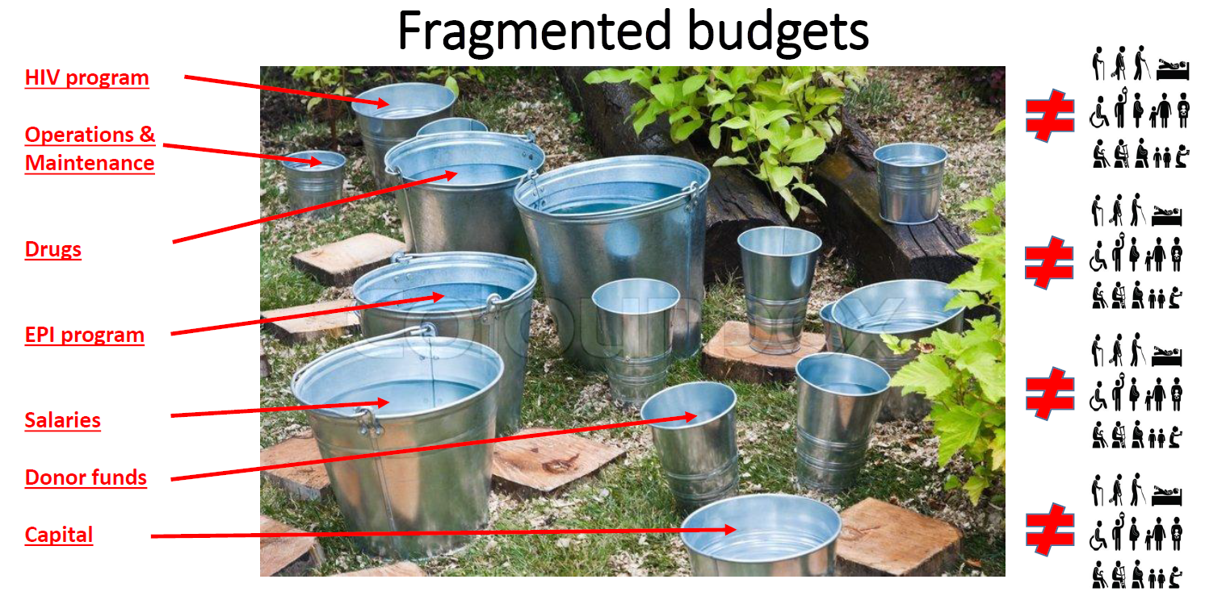
Constraint

Slide 12
PFM issues in health sector affects service delivery
Control and monitoring systems
Fiscal space
Drugs and supplies
Budget execution
Budget processes
Challenges
Availability of inputs
Budget preparation and elaboration
Allocation process
Buildings
Staffing

Slide 13

PFM in health: Implications for transitions
Where is the money coming from within the budget?
Has the Govt built funding and timing through MTEF etc
Can Government budget be used for non-state players? How to ensure accountability of NGOs
Timing and predictability of budget releases from Govt systems
Will the money comes in time to front lines? Can /should facilities receive funds (Chart of Account considerations)? Are facilities and agencies using the same chart of account
Is there flexibility for internal reallocation based on changing priorities
Are adequate controls in place at PHC level to ensure that services are delivered?

Slide 14

FinHEALTH: The toolkit for PFM in Health
A World Bank-led programmatic flagship study aims to deepen the understanding of PFM issues in health by:
Demonstrating the link between PFM, HF and health sector service delivery results through the development of a conceptual framework for linking PFM systems and bottlenecks to health outputs or results at the country level
Understanding the relationships between PFM systems and health financing functions
Studies completed: Guinea Bissau, Laos PDR, Kyrgyzstan
Studies in progress: Armenia, Myanmar

Slide 15
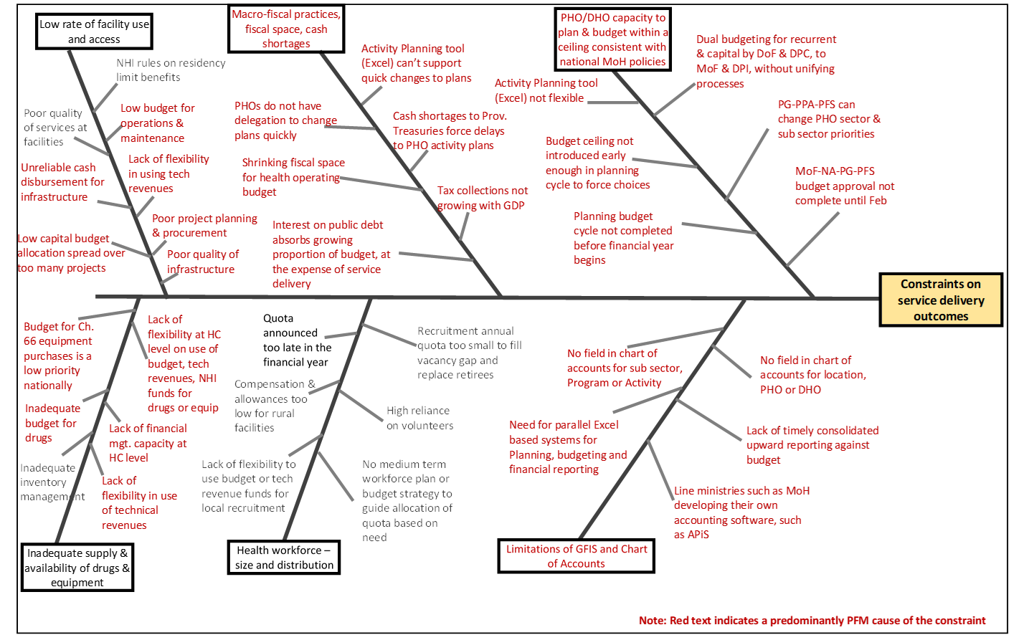
PFM IN HEALTH : Illustrative fishbone analysis

Slide 16
PFM IN HEALTH : Illustrative issues from a case study
Inherent disconnect between how the funds are allocated (case based payment) and how they are spent (input line item based on the rules applicable to the source of funds) - a typical case of mis-alignment HF reforms and PFM systems.
Need for MoF for removing this incongruence
towards a programmatic way of allocating/releasing these funds to improve service delivery (rather than incentivizing spending to abide with rules).
Health sector reforms taking place for a long time in Kyrgyz – time to take next step
adequate capacity has been created over years (1996-2016) within the system to take next step - by enhancing the autonomy at HF with appropriate governance and control arrangements (new budget code)
Incentivize service delivery to test out the appetite of the system with sufficient control and governance measures.

Slide 17
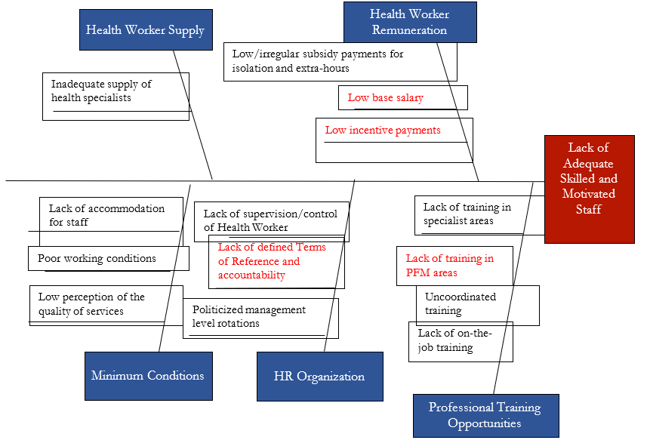
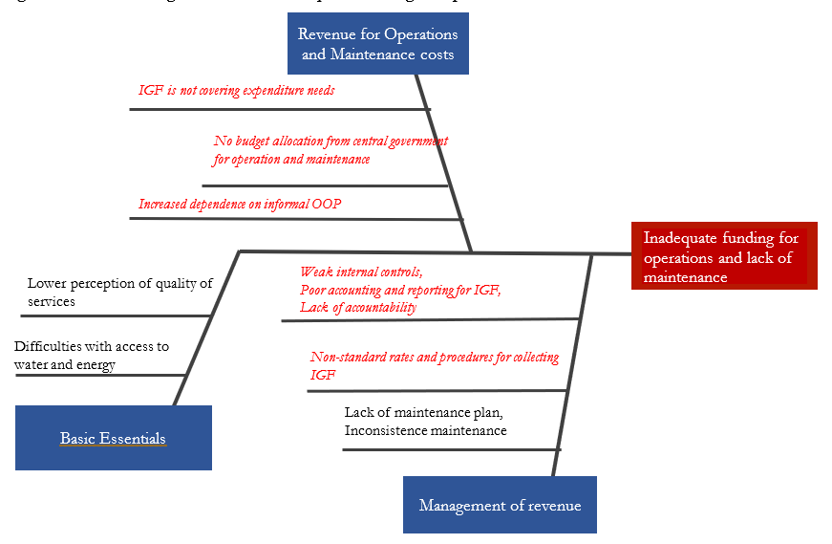
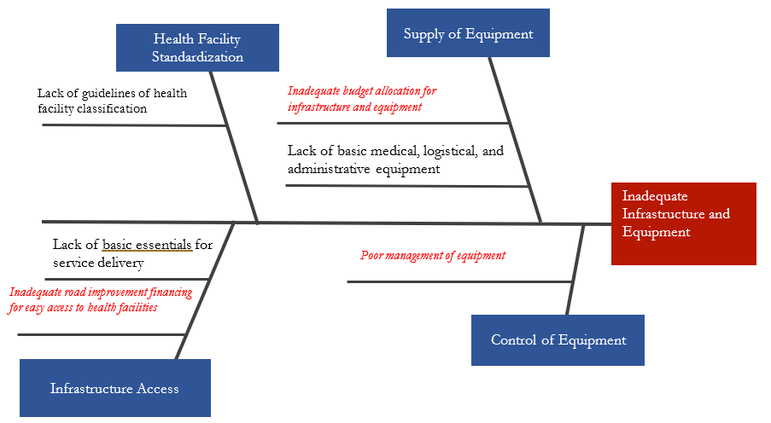
PFM IN HEALTH : Illustrative examples from a study
Strengthening availability of skilled and motivated work force
Improving availability of adequate funding for operations and maintenance
Ensuring adequate and effective investment in infrastructure and equipment

Slide 18

Group Exercise: Pick any two issues and propose solutions
Budget formulation: Health financing adequacy
Budget releases and funds flow from MoF to providers
Procurement procedures and shortages of supplies
Internal controls including accounting, Information systems
Audit: Internal & external

Slide 19

Relative strengths noticed in PFM processes from ongoing review (2019): Armenia
MTEF linked Program Budgeting at national level; flexibility at MoH & facility; Annual budget system in all public facilities; Payments from treasury on a timely basis; usually not more than 2-3 days from approval to receipt;
Near 100% expenditure and most receipts at facility through non-cash; well developed treasury and commercial bank account system;
Well developed commitment, verification, authorization & disbursement
Availability of professionally qualified finance & accounting staff
Public facilities governed by procurement law; eProcurement in place; hospitals have procurement committees and procurement trained staff; electronic auctions, request for proposal and single source options available for procurement
External audit of facilities exceeding turnover threshold
Monthly service delivery reports to SHA (MoH) doubles as budget execution report

Slide 20

Examples of PFM issues under ongoing review (2019): Armenia
Public facility Managers find the number of financial and technical reports (monthly, quarterly, semi annual and annual) to be produced burdensome and time consuming
Absence of Financial Management IT systems; only large facilities use accounting software
Facilities not significantly involved in State Budget formulation; are only advised of their annual budget allocation; top down approach of budget formulation
No budget receipts for first two months; facilities usually plan based on previous years’ cash balances; although on rare occasions, but few even had to take short-term commercial loans from banks to adjust

Slide 21

Examples of PFM issues under ongoing review (2019): Armenia
Occasional delays in receipts of medicines or referral form supplies (due to procurement challenges both at Central and local procurement), leading to non-referrals, patients having to spend out-of-pocket on medicines, and consequent dissatisfaction
Professional capacity limitations in projection of likely medicine requirements on a annual basis
Small size procurements, missing economies of scale; some times failed procurements increasing OOP
Different and ad-hoc internal procedures used by facility managers to monitor and manage revenues, expenditure and accounts payable
External mandatory audit thresholds: balance between accountability and costs & benefits

Slide 22

Examples of PFM issues under ongoing review (2019): Armenia
Low reimbursement rates for BBP services (hospital care); different reimbursement rates for different categories of BBP beneficiaries;
Public funding of health sector limited by budget constraints
Fragmentation of health budget to different programs and activities; leading to periodic revisions of facility budgets by MOH / MOF during the fiscal year
Need to absorb higher annual service costs for E-health system (not yet fully functional), when compared to former HMIS system
MoH policy departments not directly involved in budget formulation;
Weak internal audit; focus only of financial reports
Need for capacity development both at facility level and Ministries and regional departments to strengthen internal audit functions

Slide 23

Emerging suggested measures to consider for improvement of PFM in Health in Armenia in short-term perspective
Eliminate differences in reimbursement rates for the same type of BBP services for different categories of beneficiaries; revise and simplify the BBP structure (eligibility criteria and exceptions for different services and groups of population)
Revise the purchasing and contracting arrangements for BBP services to provide more predictability and stability of public funding flow throughout the fiscal year (e.g. consider signing three-year contracts with health facilities, given the availability of budget funds)
Centralize the procurement of most commonly used medicine and supplies for public facilities through MoH (starting with regional PHC facilities with small-scale needs); improve the supply chain management to reduce operational costs for storage and distribution
Systematize the reporting requirements for health facilities (at least to different categories); reduce and eliminate duplicating and ad-hoc reports.

Slide 24
Discussion:
How can we do better?

